Slide 1
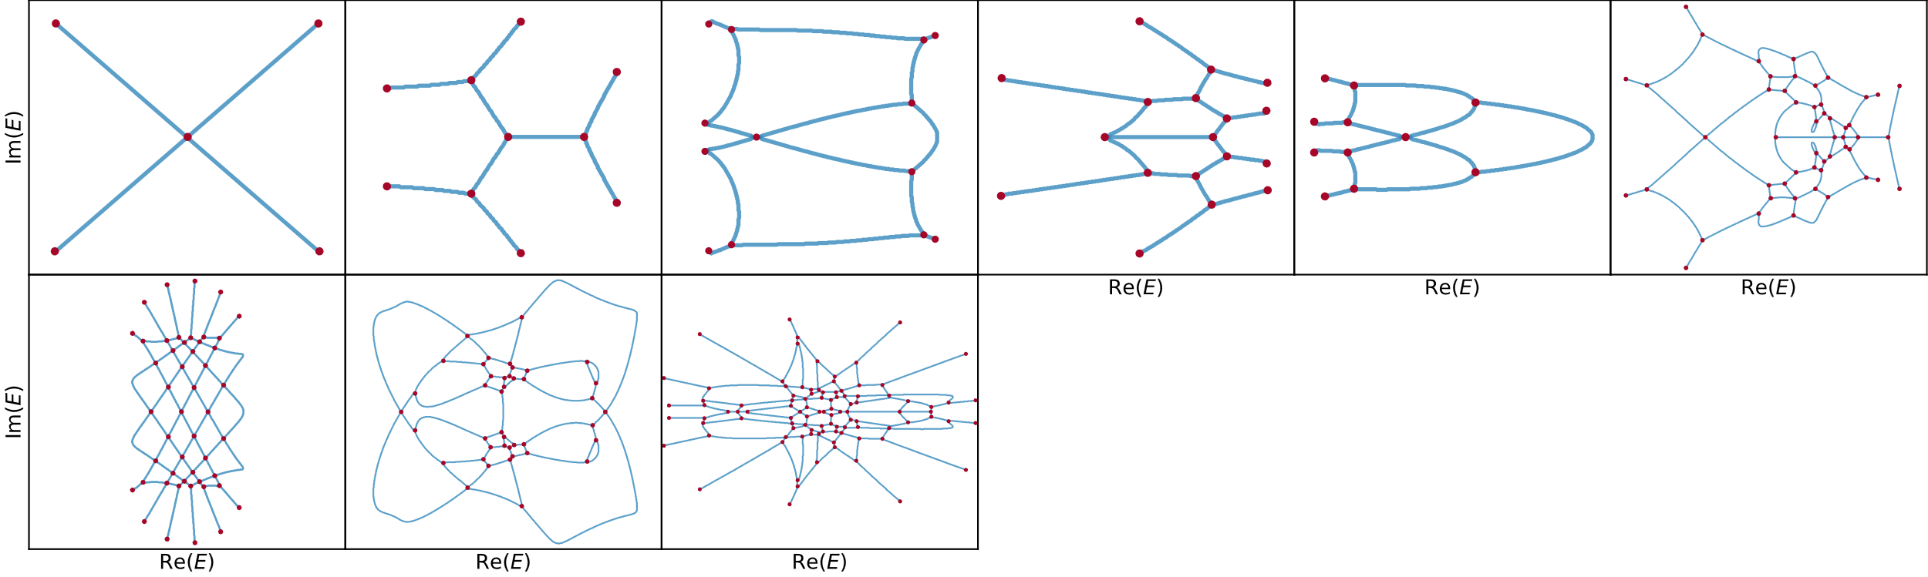
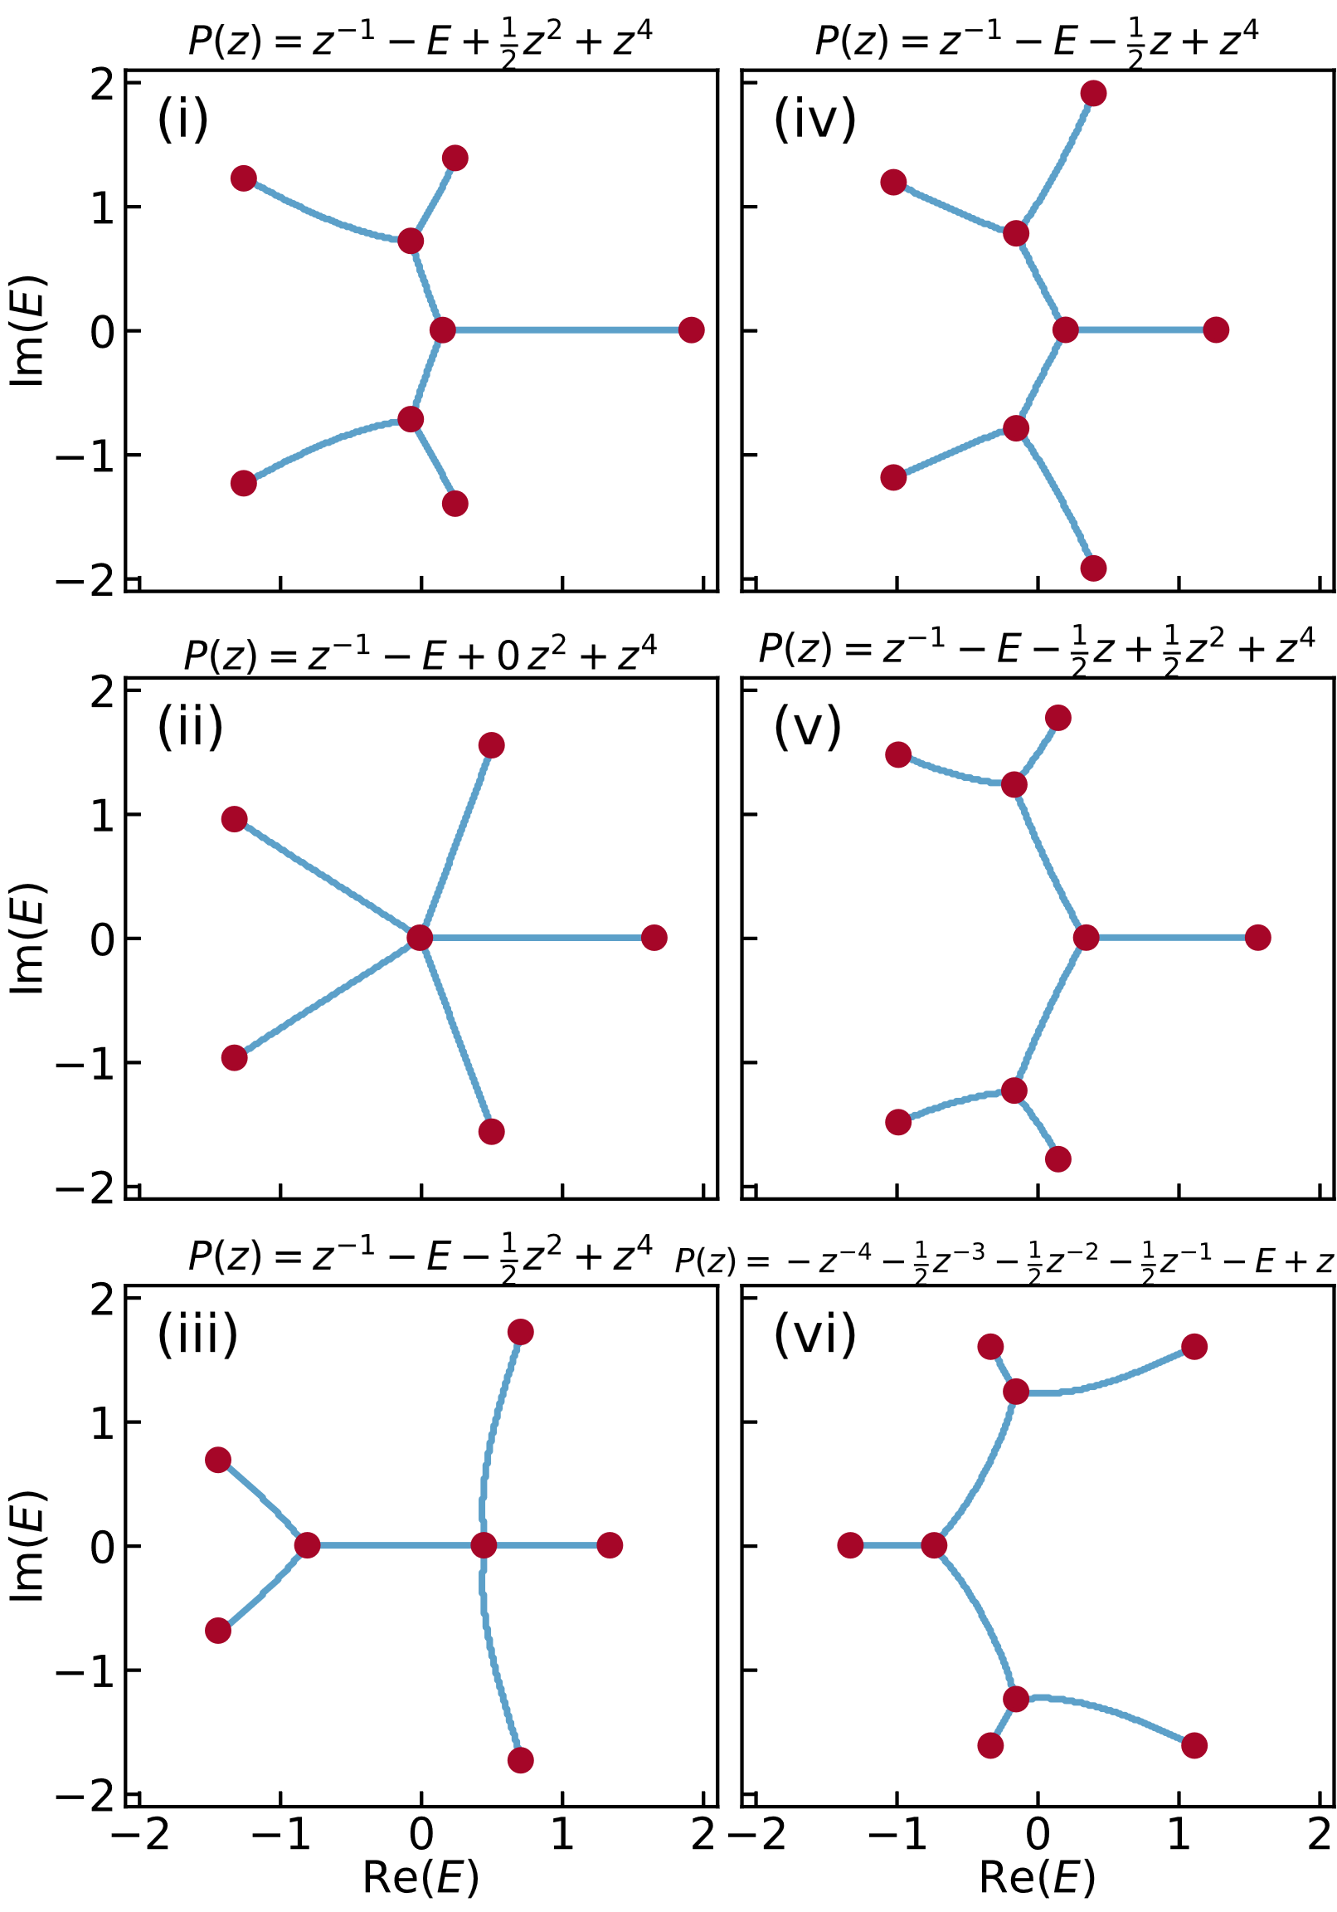
(a)
(c)
… …

Slide 2
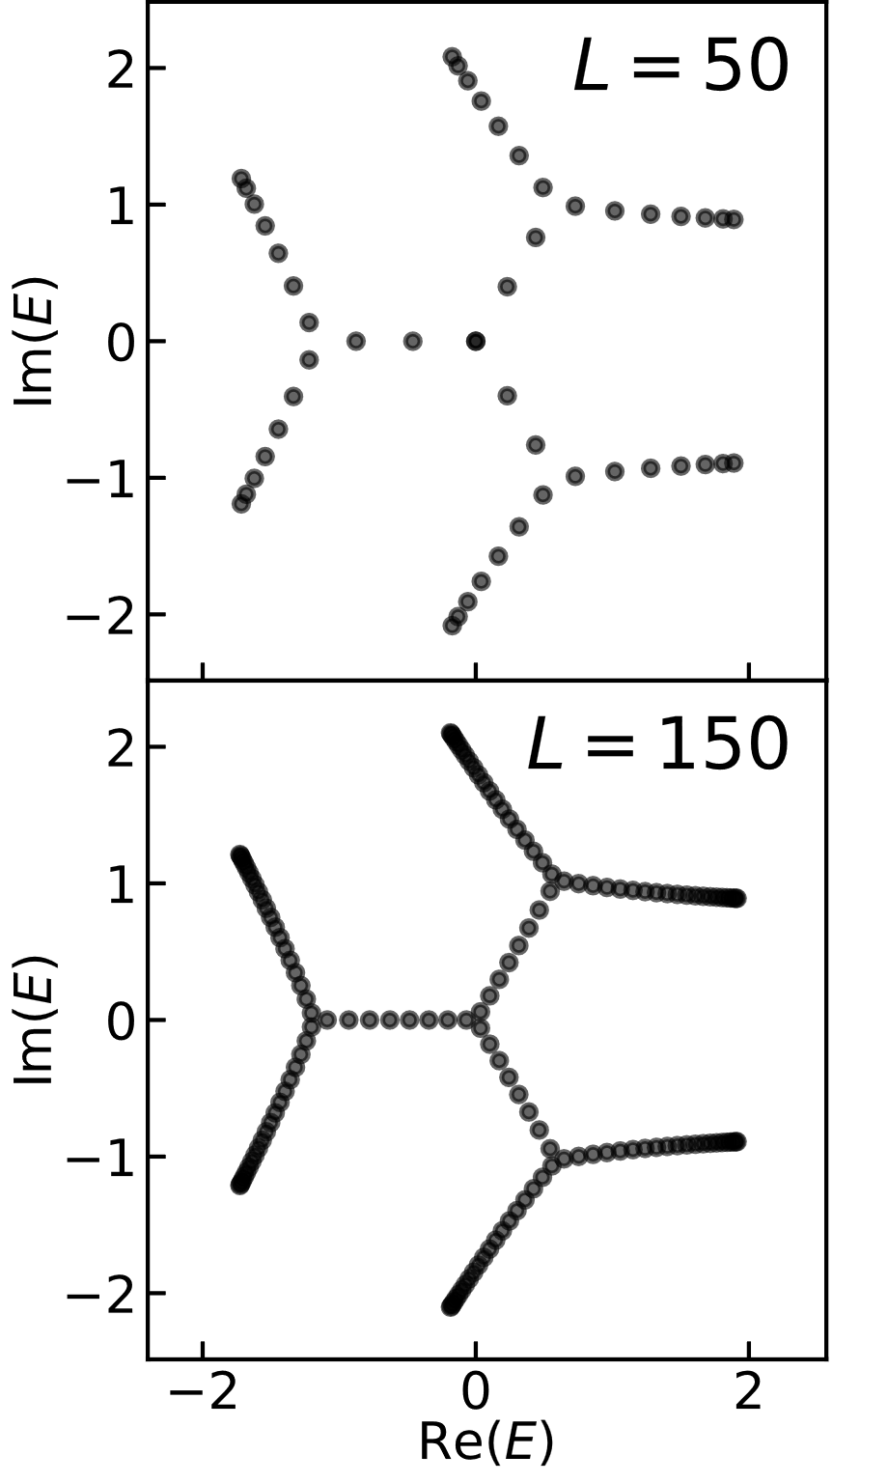
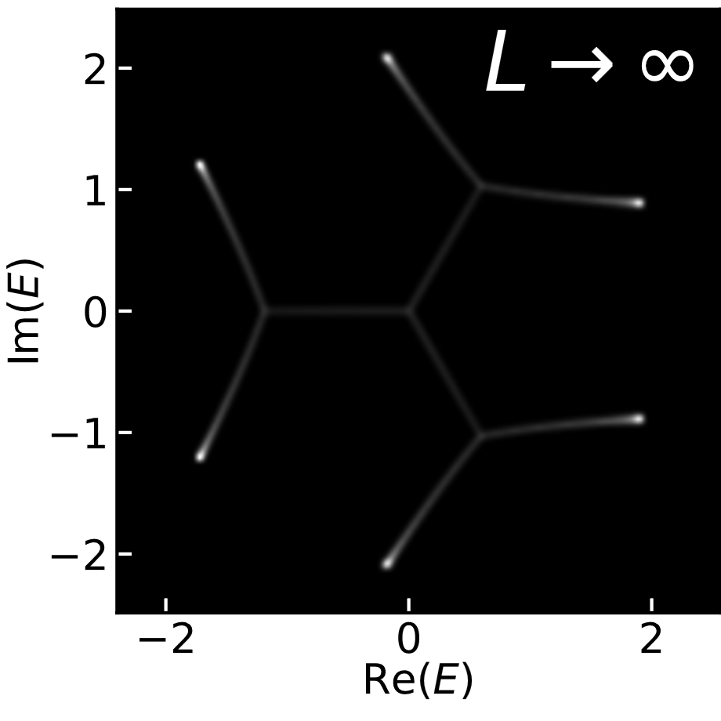
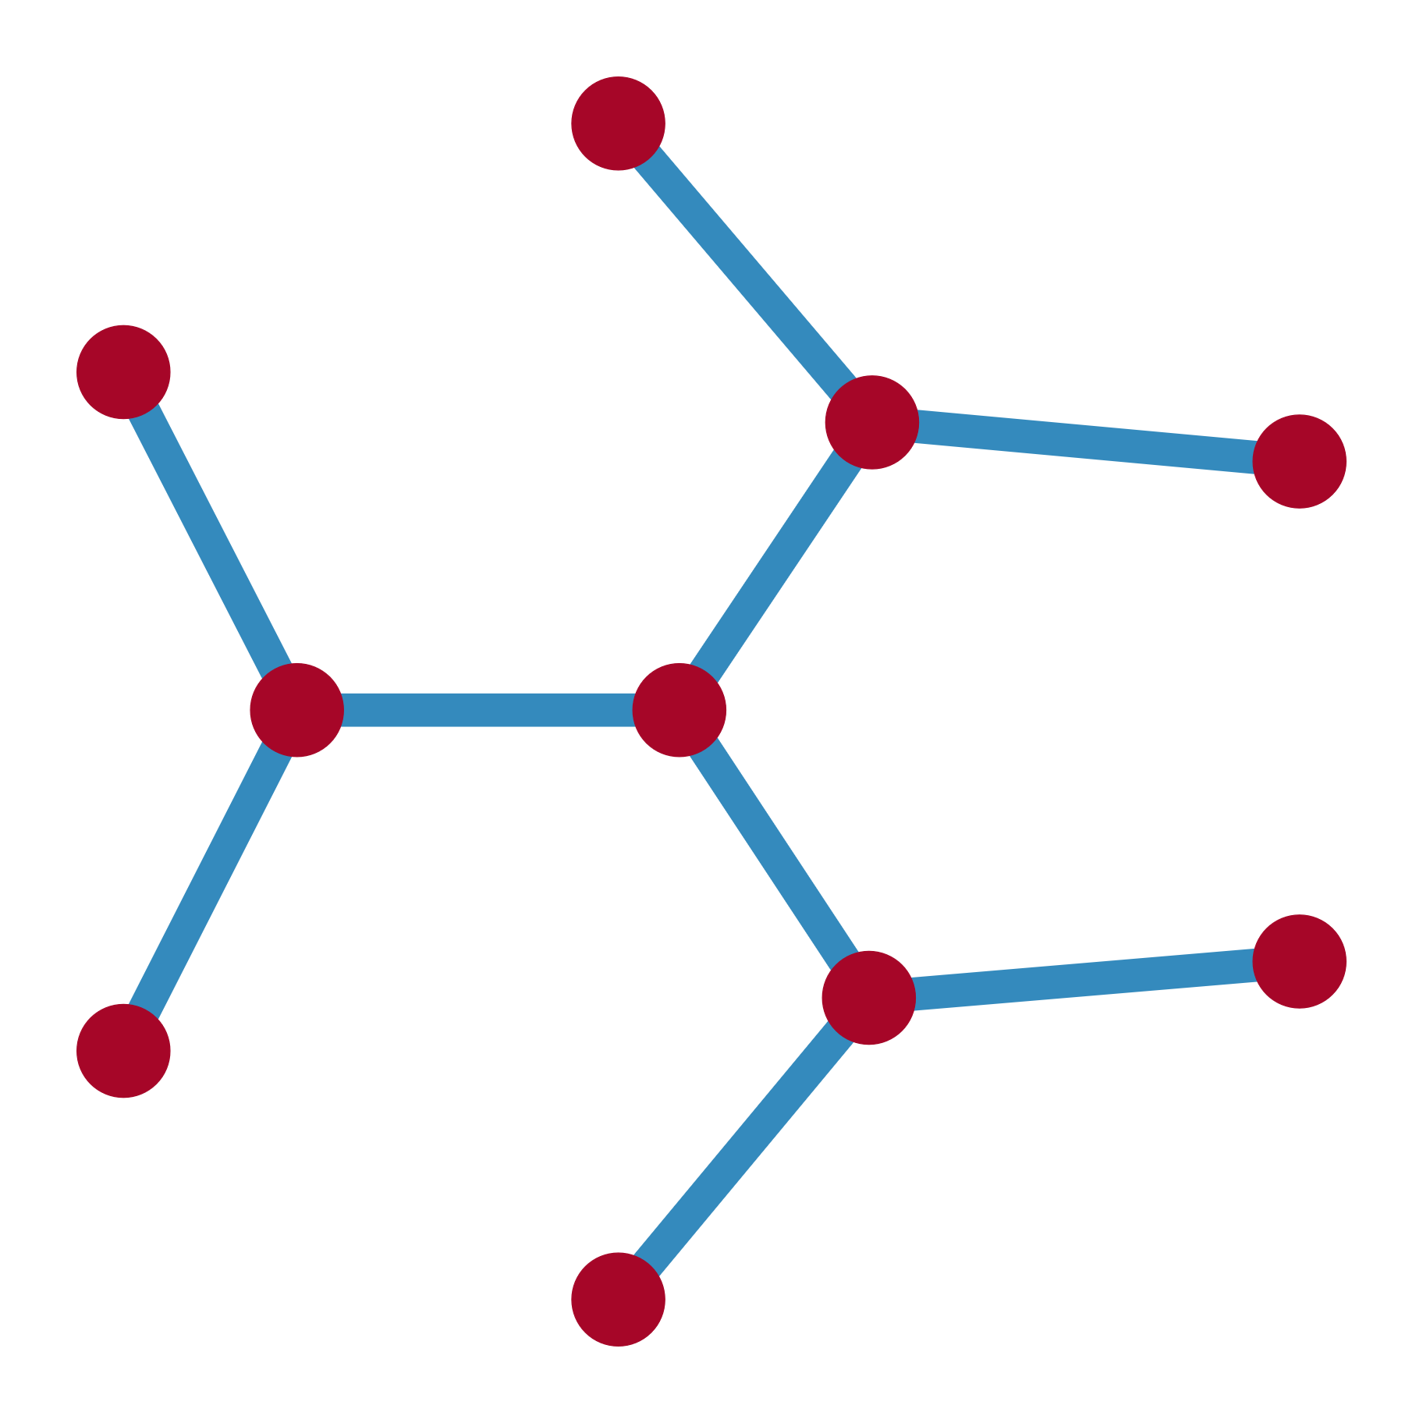
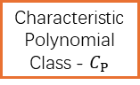
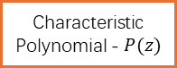
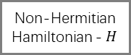
(b)
Non-Hermitian
Hamiltonian - $H$
Characteristic
Polynomial - $P(z)$
Characteristic
Polynomial Class - $C_{P}$
Energy Spectrum
GnLTransformer
poly2graph
Spectral Graph - G

Slide 3
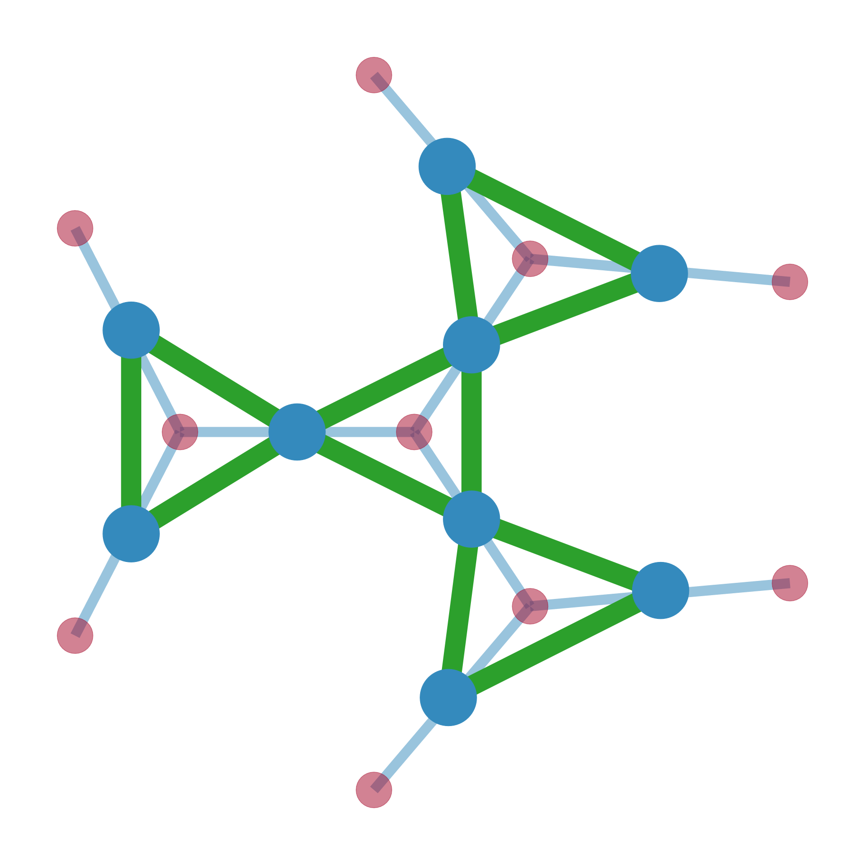
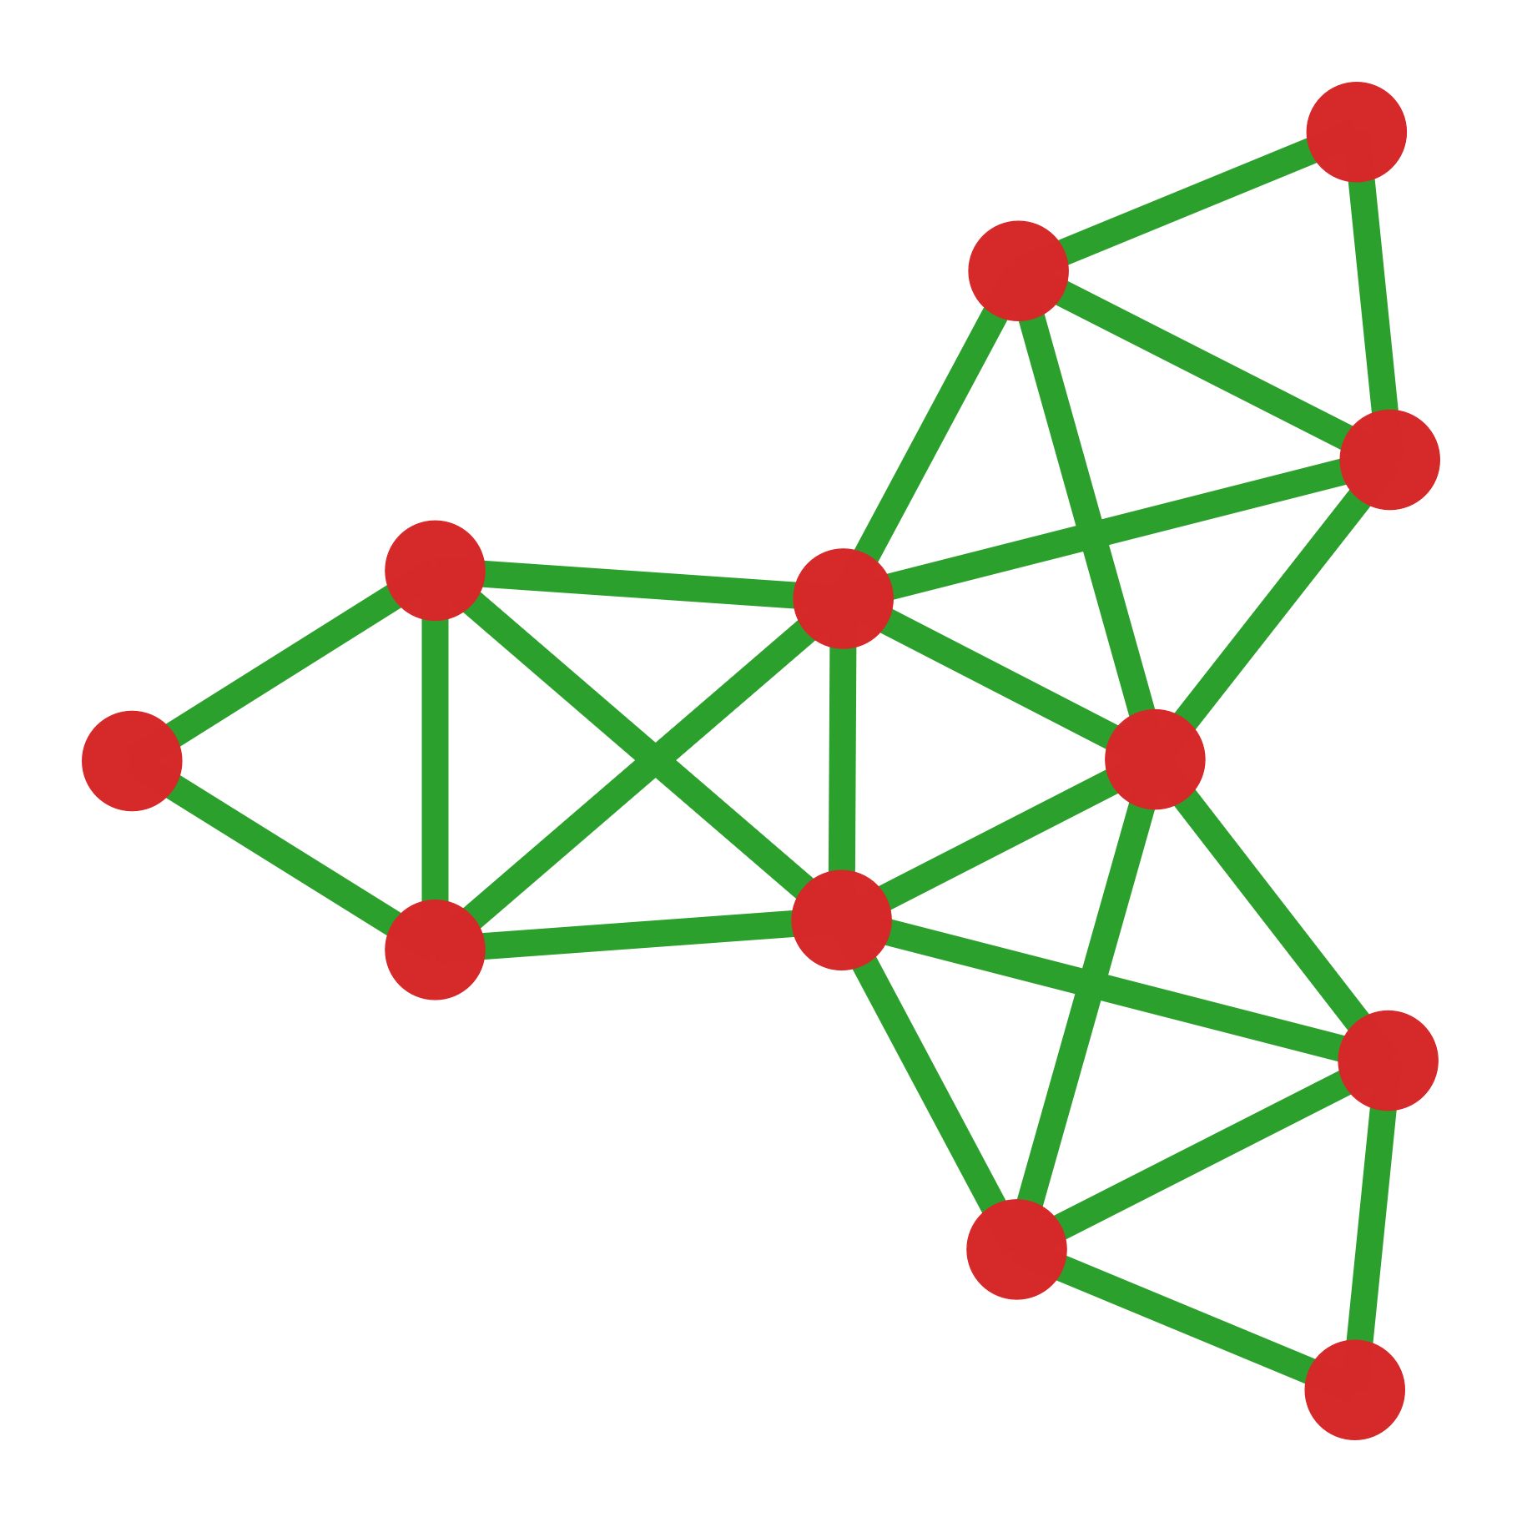
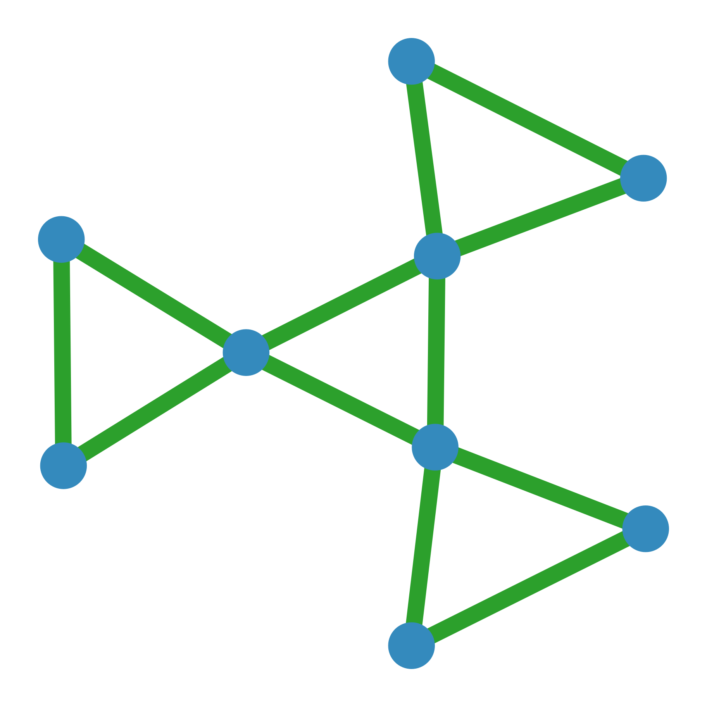
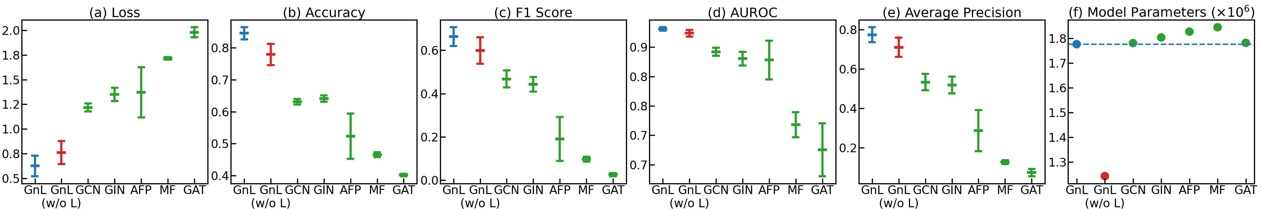
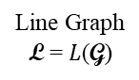
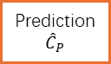
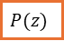
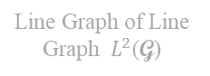

(a)
Line Graph of Line Graph $L^{2}$(G)
…
…
Test Accuracy
99.78% ± 0.05%
Attentive Convolution & GRU Readout
Line Graph
L = $L$(G)
SAGPooling
Spectral Graph G
Prediction
$${\hat{C}}_{P}$$
$$P(z)$$
MLP
CrossEntropy
$$P(z)$$
poly2graph
Concatenation
Truth
$$C_{P}$$

Slide 4
(a)
(c)
… …
(b)
Non-Hermitian
Hamiltonian - $H$
Characteristic
Polynomial - $P(z)$
Characteristic
Polynomial Class - $C_{P}$
Energy Spectrum
GnLTransformer
poly2graph
Spectral Graph - G

Slide 5

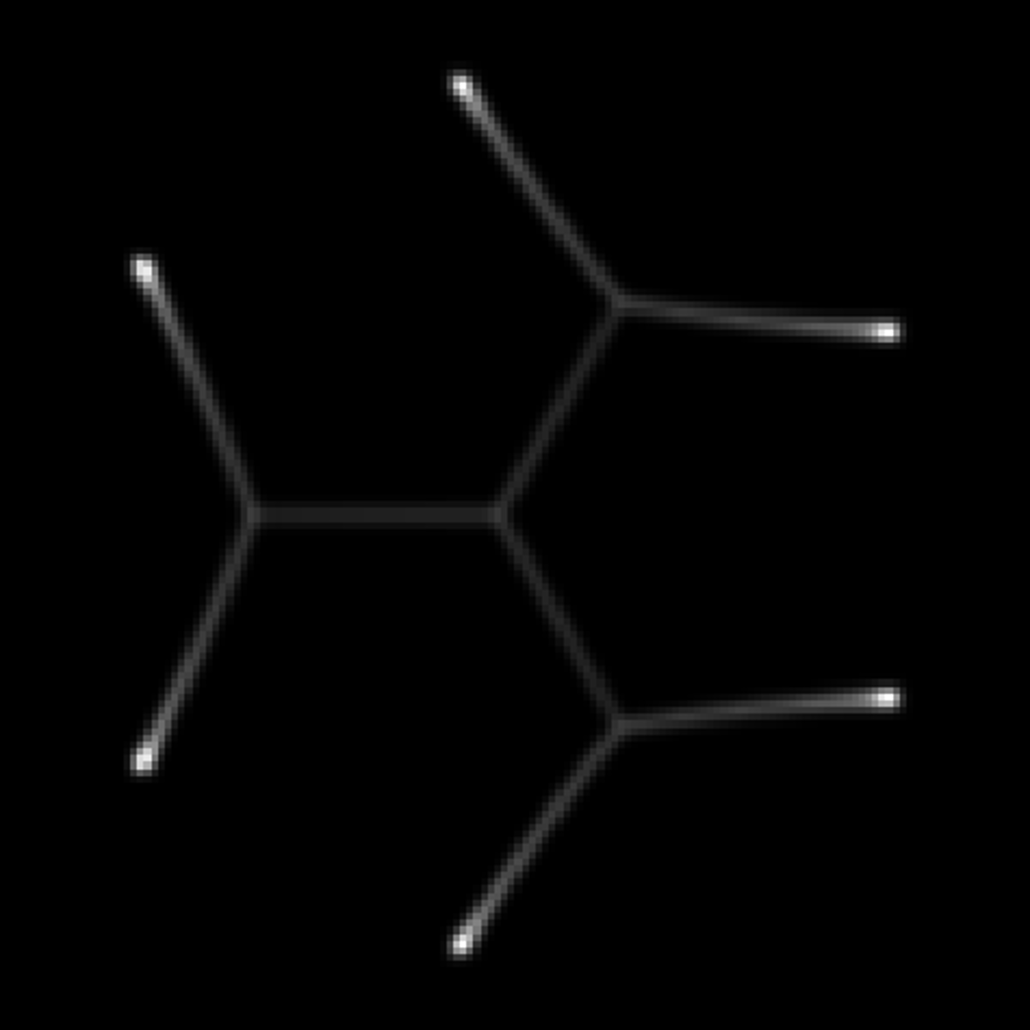
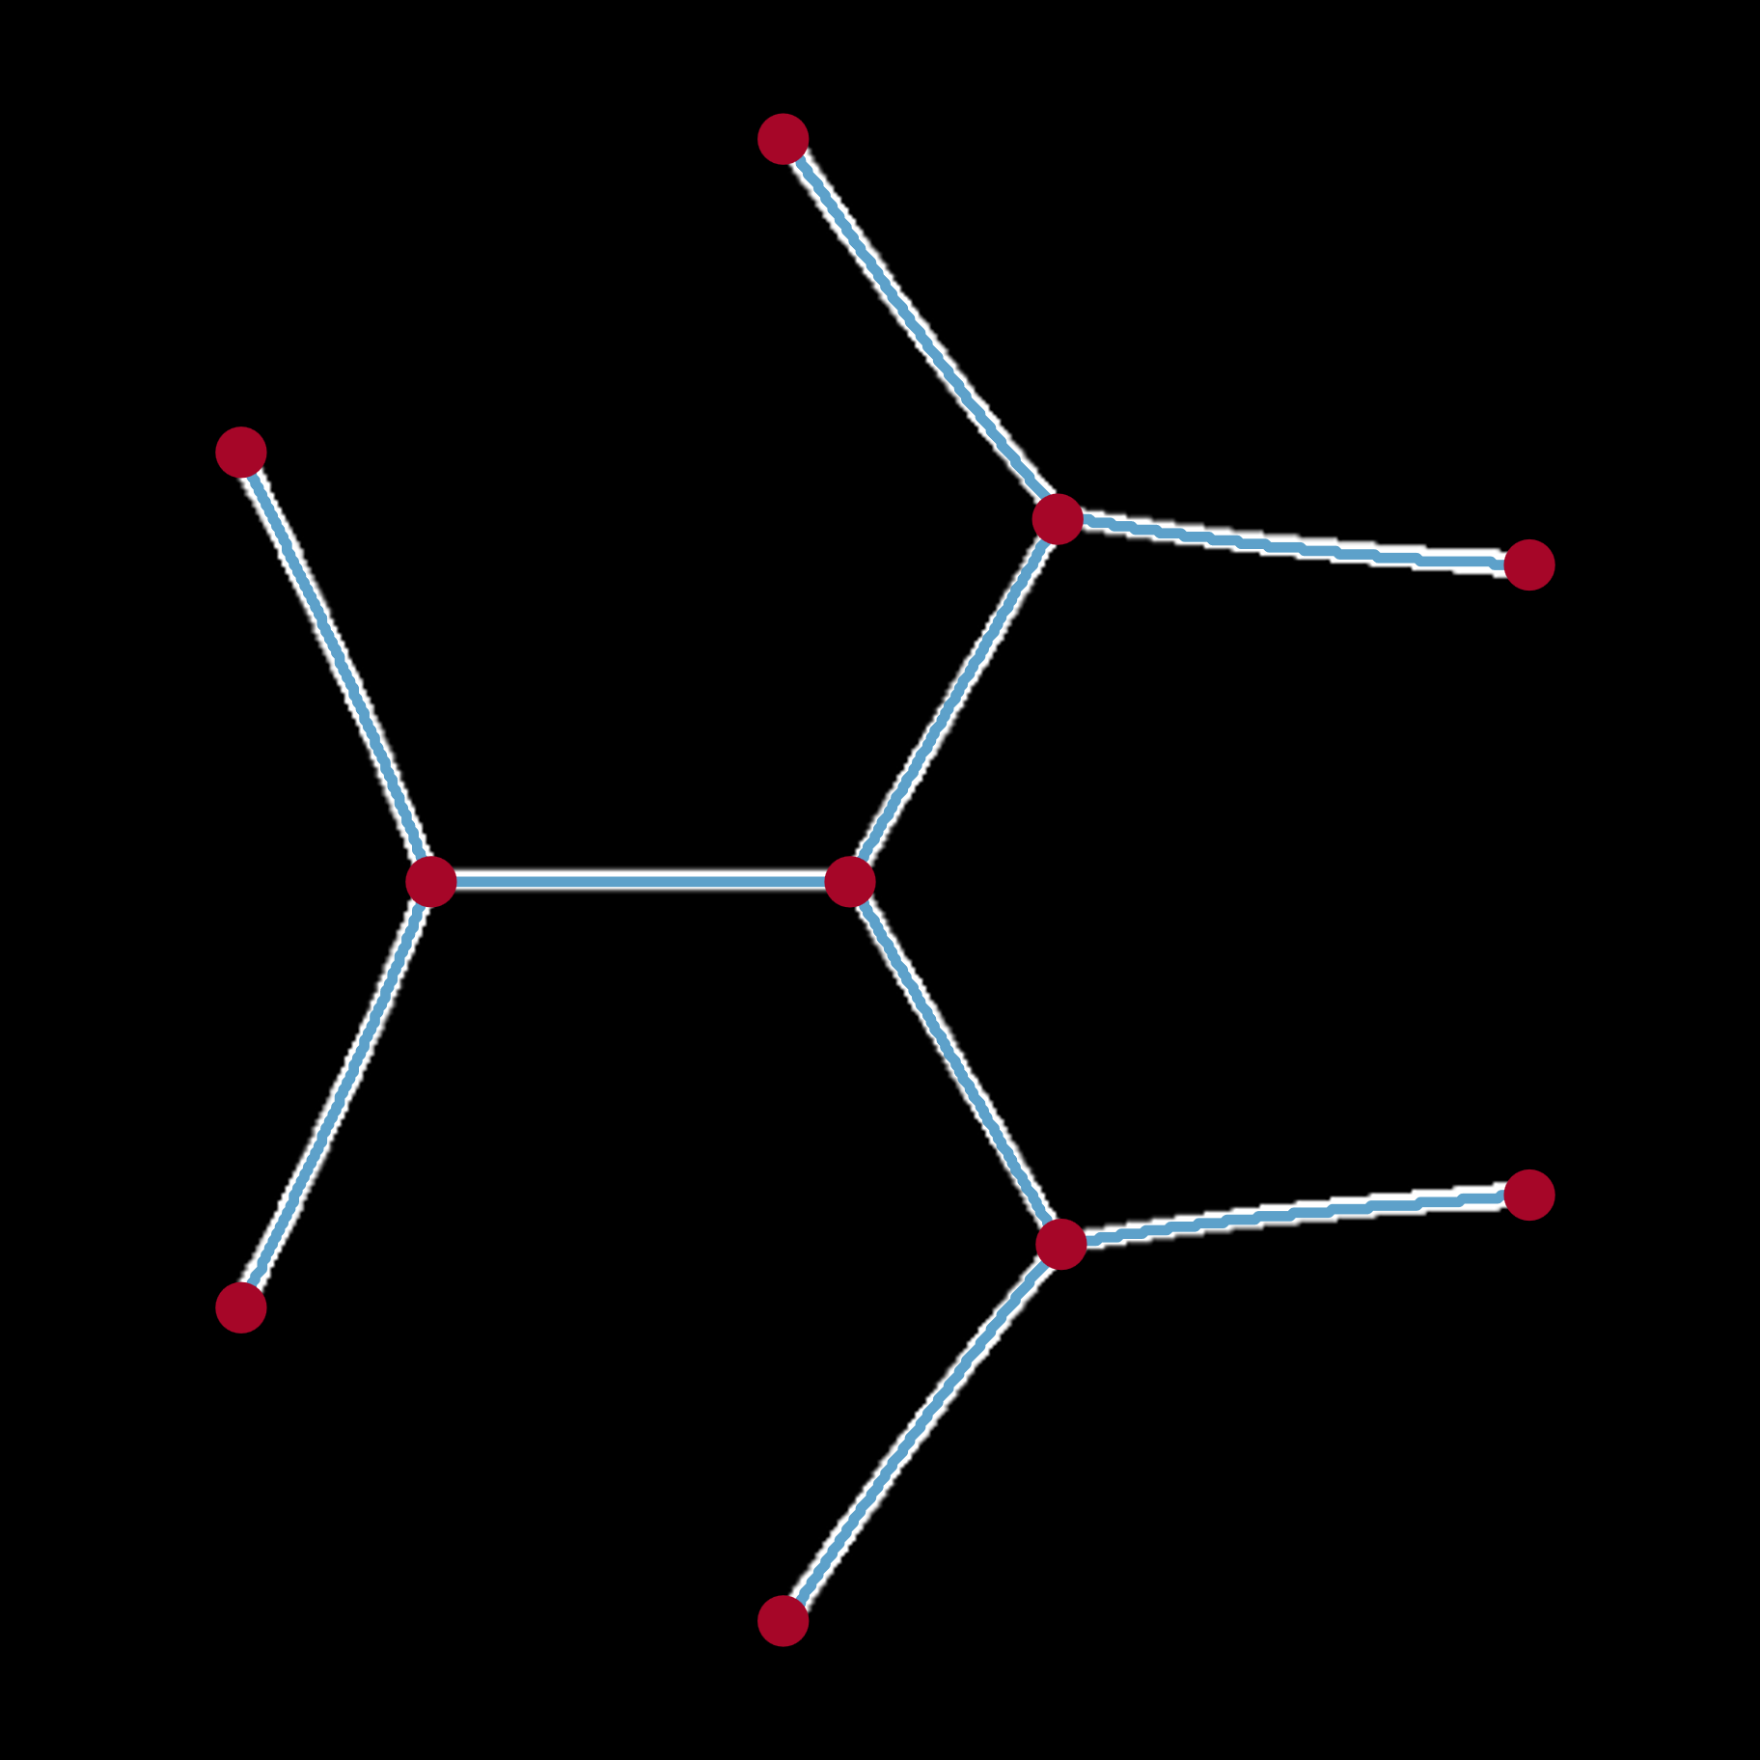

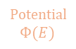
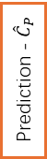
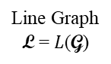
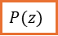
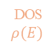
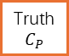
(c)
Line Graph of Line Graph $L^{2}$(G)
…
…
Attentive Convolution & GRU Readout
Line Graph
L = $L$(G)
SAGPooling
Potential
$$Φ(E)$$
Graph
Skeleton
Prediction - ${\hat{C}}_{P}$
$$P(z)$$
MLP
Concatenation
DOS
$$ρ(E)$$
Spectral Graph G
Truth
$$C_{P}$$
(a) Poly2Graph
(b) GnLTransformer

Slide 6
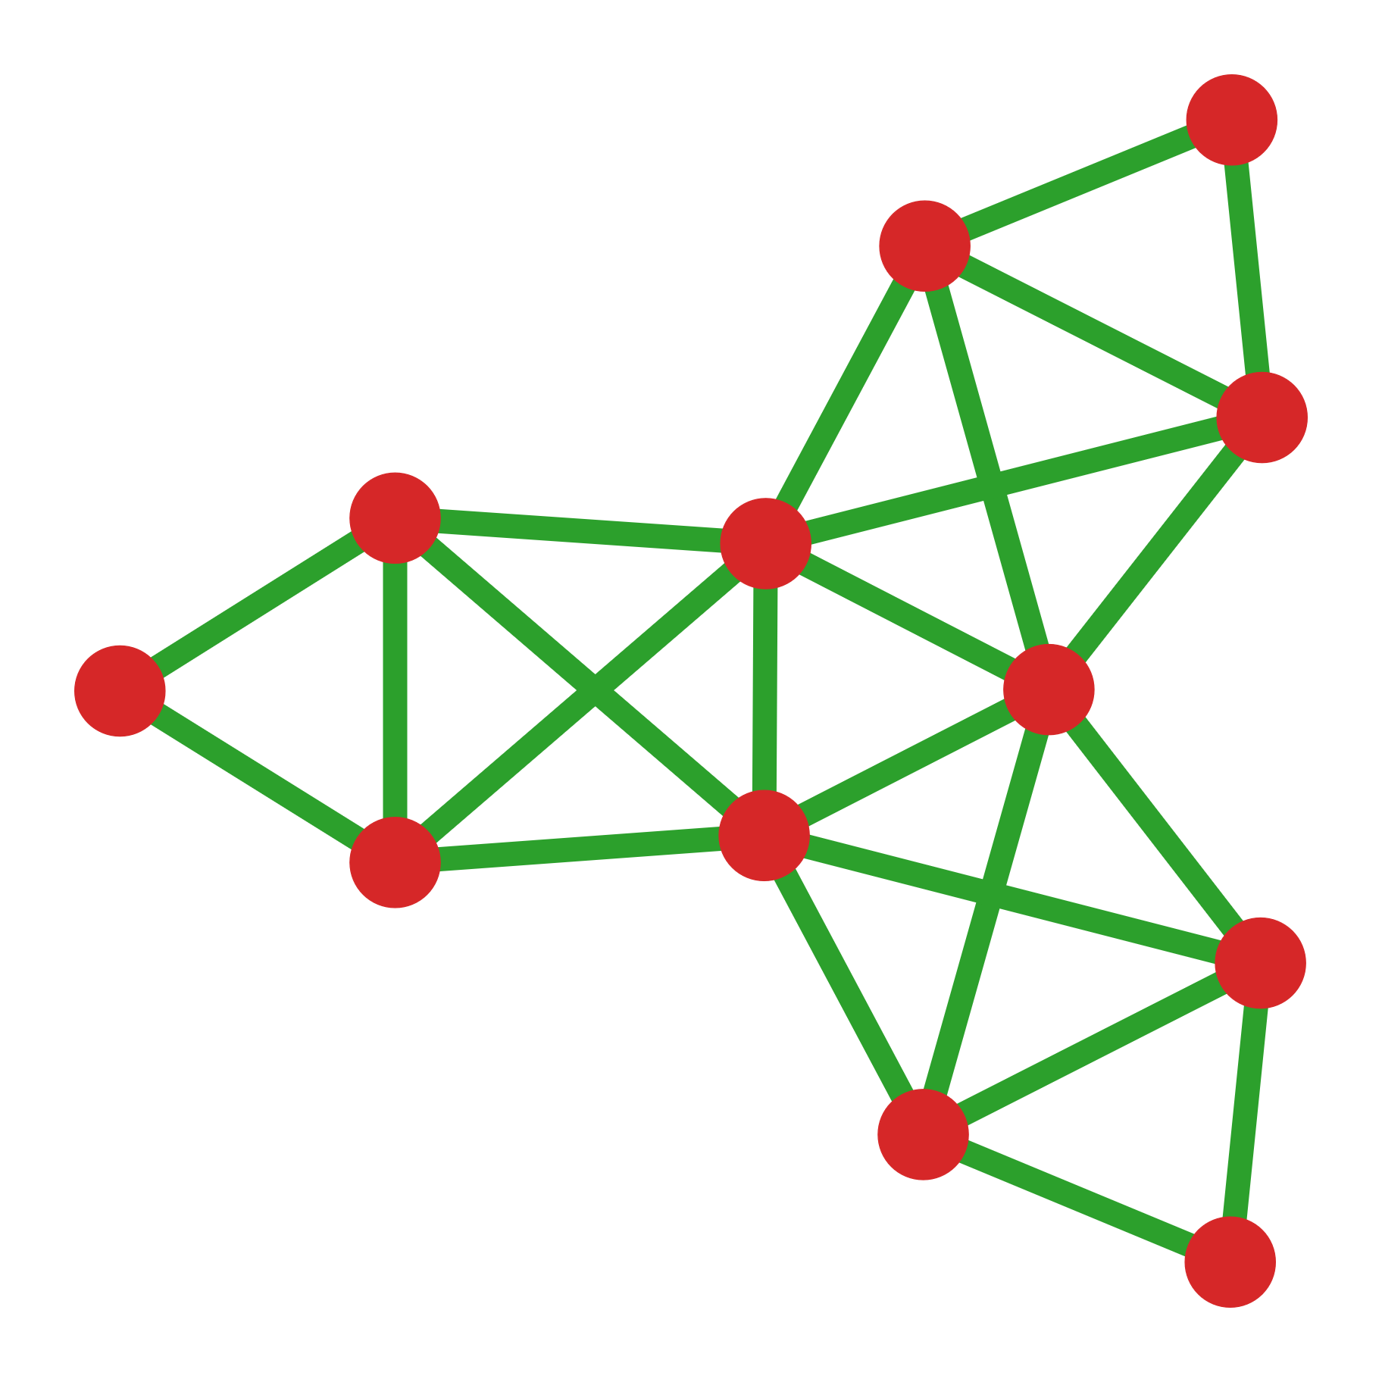
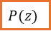
(c)
$$P(z)$$
poly2graph

